Slide 1
Heap Sort

Slide 2
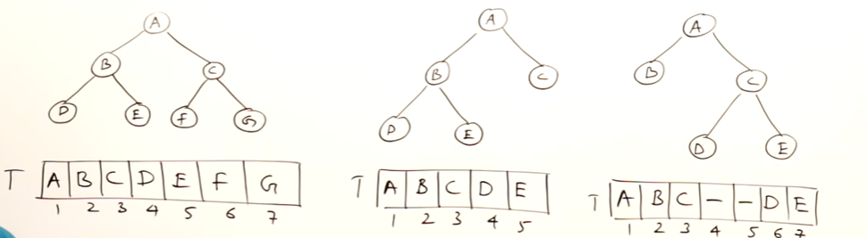
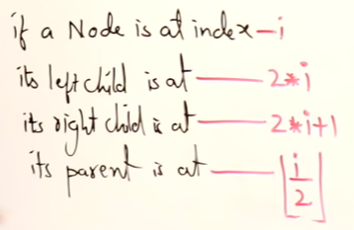
Array representation of a Binary Tree
Full Binary tree: A BT of height h with maximum no. of nodes (2^{h+1} - 1)
Complete Binary Tree: If there is no missing element in array representation of a BT, then it is a complete BT.

Slide 3
The Heap Data Structure
Def: A heap is a nearly complete binary tree with the following two properties:
Structural property: all levels are full, except possibly the last one, which is filled from left to right
Order (heap) property: for any node x
Parent(x) ≥ x
From the heap property, it follows that:
“The root is the maximum
element of the heap!”
8
7
4
5
2
Heap
A heap is a binary tree that is filled in order

Slide 4
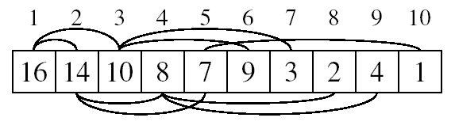
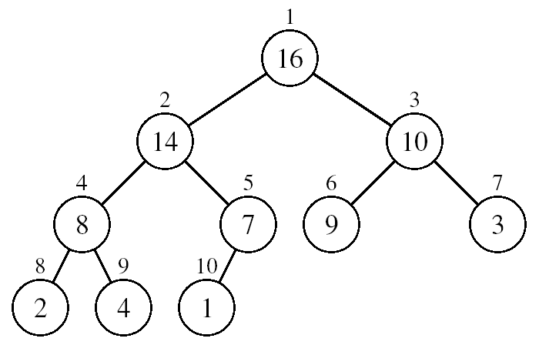
Array Representation of Heaps
A heap can be stored as an array A.
Root of tree is A[1]
Left child of A[i] = A[2i]
Right child of A[i] = A[2i + 1]
Parent of A[i] = A[ ⎣i/2⎦ ]
The elements in the subarray A[(⎣n/2⎦+1) .. n] are leaves

Slide 5
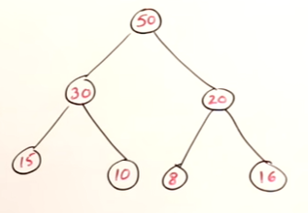
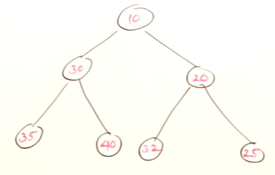
Heap Types
Max-heaps (largest element at root), have the max-heap property:
for all nodes i, excluding the root:
A[PARENT(i)] ≥ A[i]
Min-heaps (smallest element at root), have the min-heap property:
for all nodes i, excluding the root:
A[PARENT(i)] ≤ A[i]

Slide 6
Heap Tree Construction
Two methods:
Insert key one by one in the given order
Heapify Method (Insert all elements at a time and then apply Heapify method)

Slide 7




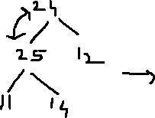
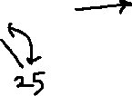
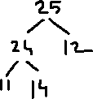
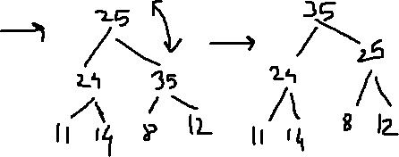


Heap Tree Construction:Method 1 (Insert key one by one in the given order)
14,24,12,11,25,8,35
In this method, we are adjusting the elements from leaf to root i.e adjustments are upwards.

Slide 8
Heap Tree Construction:Method 1 Analysis (Insert key one by one in the given order)
Best case: Inserting a key in empty heap : O(1)
Worst case: log n comparisons + log n swappings required : O(log n)
Inserting n elements ,TC= O(nlogn)

Slide 9
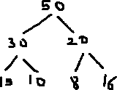
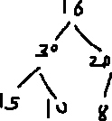
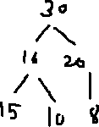


Deletion in Max heap
The only element that can be deleted is root element.
Time taken to delete one element depends on height of heap=log n
TC=O(n log n)

Slide 10
Heap sort
Two steps:
Create heap for given set of elements by inserting elements one by one
From the heap go on deleting the elements and keep deleted elements in the empty locations in an array (representing the heap).

Slide 11
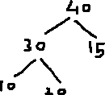



Heap Sort
10,20,15,30,40
Delete 40
Delete 30
Delete 20
40 | 30 | 15 | 10 | 20
30 | 20 | 15 | 10
20 | 10 | 15
15 | 10
Delete 15
Delete 10
10

Slide 12
Heap sort : Time Complexity
Time taken by heap sort = Time taken to insert n elements into heap + Time taken to delete n elements from heap
= nlogn + nlogn = 2nlogn
Hence TC = O(nlogn)

Slide 13
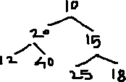
Heap Tree Construction: Method 2 (Insert all elements at a time and then apply heapify method )
Heapify method: In method 1 of heap creation, we were adjusting the elements from leaf to root i.e adjustments were upwards.
Heapify method adjusts the elements downwords.
10 | 20 | 15 | 12 | 40 | 25 | 18

Slide 14
Create Heap for 10,20,15,12,40,25,18
Check for 20. 20 violates maxheap condition. swap 20 with 40
18 ,25,40,12 are heaps. Check for 15.
15 violates maxheap condition . Replace 15 with max(25,18) i.e 25
Check for 10. Here 10 violates maxheap condition. swap 10 with 40
Now 10 violates maxheap condition. so swap 10 with 20

Slide 15
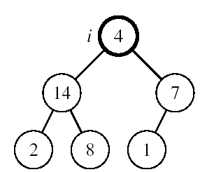
Maintaining the Heap Property
Suppose a node is smaller than a child
Left and Right subtrees of i are max-heaps
To eliminate the violation:
Exchange with larger child
Move down the tree
Continue until node is not smaller than children

Slide 16
Alg: MAX-HEAPIFY(A, i, n)
l ← LEFT(i)
r ← RIGHT(i)
if l ≤ n and A[l] > A[i]
then largest ←l
else largest ←i
if r ≤ n and A[r] > A[largest]
then largest ←r
if largest ≠ i
then exchange A[i] ↔ A[largest]
MAX-HEAPIFY(A, largest, n)
Alg: BUILD-MAX-HEAP(A)
n = length[A]
for i ← ⎣n/2⎦ down to 1
do MAX-HEAPIFY(A, i, n)
1
4
2
3
1
3
4
5
6
7
2
16
9
10
8
9
10
14
8
7
4 | 1 | 3 | 2 | 16 | 9 | 10 | 14 | 8 | 7

Slide 17
Heap Sort Complexity
Inserting n nodes to create heap(using heapify method) + Deleting n nodes from heap
= n + nlogn
TC=O(n logn)

Slide 18
Problems
Demonstrate, step by step, the operation of Build-Heap on the array
A=[5, 3, 17, 10, 84, 19, 6, 22, 9]

